Slide 1
The Alliance
4 Universities
At the forefront of research,
academic excellence,
and technology & innovation

Slide 2
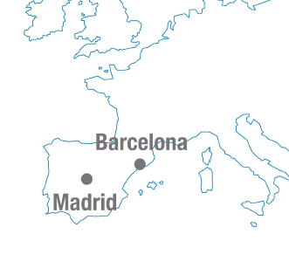
A strategic partnership of
4 leading Spanish
public universities
Universitat Autònoma de Barcelona
Universidad Autónoma de Madrid
Universidad Carlos III de Madrid
Universitat Pompeu Fabra in Barcelona
Notes:
Just over 2 years ago, at the beginning of 2008, 4 universities (2 from Barcelona and 2 from Madrid), namely, the Universitat Autònoma de Barcelona, the Universidad Autónoma de Madrid, the Carlos III University of Madrid and the Pompeu Fabra university, all of them based on a strong connection between academic research and quality teaching, all of them among the very best centres of higher education in Spain and in the European Union for their teaching quality, the excellence of their research and their capacity for innovation, decided to formalise their collaboration. And so the Alliance of these 4 universities, the A4U, was created. It is an innovative structure both in Spain and in Europe.

Slide 3
Why these 4 Universities?
A-4U members are 4 public universities which are national leaders in teaching and research. All four are in Top 50 Under 50 QS ranking 2016.
A-4U members have been recognised as Campuses of International Excellence by an international expert committee appointed by the Spanish Government acknowledging their leading position in research and teaching.
A-4U members are leaders in transfer of knowledge and technology, since all 4 universities house Research Parks and have generated a considerable number of spin-off companies in Spain.
Support by the Spanish Government: Spanish Institute of Foreign Trade (ICEX).

Slide 4
University Figures
Founded in | 1968 | 1968 | 1989 | 1990
Total Number of Students | 49.338 | 28.962 | 20.269 | 12.195
International Students | 15% | 10,89% | 19,60% | 24%
Bachelor Degrees | 87 | 49 | 38 | 24
Master Degrees | 133 | 82 | 87 | 87
PhD Programmes | 68 | 84 | 19 | 9

Slide 5
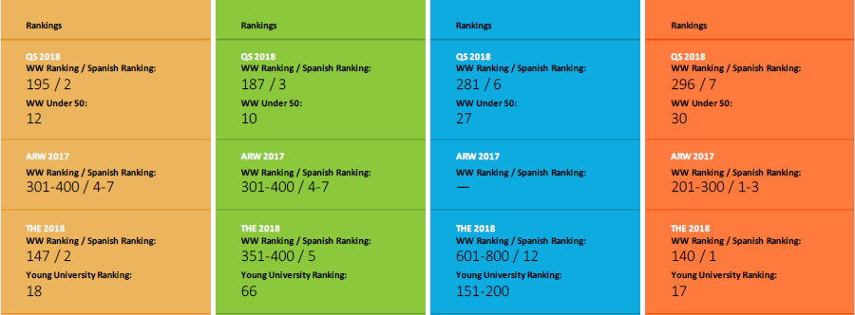
Rankings

Slide 6
A-4U Objectives
International mobility of students, researchers and academics
Research partnerships worldwide
English-taught degrees
International profile

Slide 7
A-4U Joint Projects
Promotion of European research activities through a permanent office in Brussels (OPERA), which facilitates participation of A-4U researchers in European programmes and decision-making.
IUNE Observatory - an information database for the evaluation of research in Spanish universities, recognised by the Ministry of Education of Spain.
Common strategy of internationalisation
India, Indonesia, Brazil, Russia, South Africa, Turkey, Iran, Saudi Arabia, Qatar, United Arab Emirates, Malaysia.
Joint undergraduate programme
Philosophy, Politics and Economics (since 2013)

Slide 8
Main activities in joint internationalisation
Relations with the leading universities in BRICS and other countries
MOUs and specific agreements of cooperation
Mobility of teaching staff and researchers
Reciprocal visits and thematic seminars for future projects
Promote our academic programs
Attract international talent
Scholarships, institutional visits, promotion events, and education fairs.
Cooperation with institutions and official bodies:
Spanish Institute for Foreign Trade, Embassies, Instituto Cervantes, Spain-India and Spain-China Council Foundations.

Slide 9
Participation in International Mobility Programmes
A4U is active and successful in participating in Erasmus+ international mobility projects.
In 2015 and 2016 calls, 142 scholarships for mobility with Russia and South Africa were available for bachelor students, master students, PhDs and university professors.
In 2017 call, 88 scholarships are available for mobility with Russia, South Africa, India, Indonesia and Iran.

Slide 10
Erasmus +
International Credit Mobility
Mobility programme for higher education between program and partner countries (KA107)
Notes:
Namaste [namasté].
Ladies and gentlemen, distinguished guests, fellow rectors,
As President of the Alliance, it is a great pleasure for me to be here and to present our partnership to you.

Slide 11
The new Erasmus program + with partner countries
Erasmus+: In the framework of the New European Commision Strategy 2014-2020
More opportunities: Beyond EU borders: Erasmus mobility is open to third countries
Aim: Enhance education and training capacities to improve students, teachers and workers employability
Funding: European Commission through National Agency (SEPIE)
Notes:
We are national leaders in quality of teaching and research
We are the four Main Spanish actors in Europe and account for 20% of the total Spanish Universities participation in European Union programmes
Each university has been officially recognised as a Campus of International Excellence by the Spanish Ministry of Education.
All four universities house Research Parks and have generated a considerable number of spin-off companies in Spain.
We are officially supported by the Spanish government through agreements with the Spanish Institute for Foreign Trade (ICEX) and Spanish National Research Council (CSIC)
United by many years of good relationships, mutual collaboration, and shared commitment to high-quality scientific research and teaching excellence.

Slide 12
Who can benefit from Erasmus+?
Region | Countries/Territories
REGION 1 - Western Balkans | Albania, Bosnia & Herzegovina, Kosovo*, Montenegro, Serbia
REGION 2 - Eastern Partnership countries | Armenia, Azerbaijan, Belarus, Georgia, Moldova, Territory of Ukraine
REGION 3 - South-Mediterranean countries | Algeria, Egypt, Israel, Jordan, Lebanon, Libya, Morocco, Palestine, Syria, Tunisia
REGION 4 - Russian Federation | Territory of Russia
REGION 5 | Andorra, Monaco, San Marino, Vatican City State
REGION 6 - Asia | Afghanistan, Bangladesh, Bhutan, Cambodia, China, DPR Korea, India, Indonesia, Laos, Malaysia, Maldives, Mongolia, Myanmar, Nepal, Pakistan, Philippines, Sri Lanka, Thailand and Vietnam
REGION 7 - Central Asia | Kazakstan, Kyrgyzstan, Tajikistan, Turkmenistan, Uzbekistan
REGION 8 - Latin America | Argentina, Bolivia, Brazil, Chile, Colombia, Costa Rica, Cuba, Ecuador, El Salvador, Guatemala, Honduras, Mexico, Nicaragua, Panama, Paraguay, Perú, Uruguay, Venezuela
REGION 9 | Iran, Iraq, Yemen
REGION 10 - South Africa | South Africa
REGION 11 - ACP | Angola, Antigua and Barbuda, Bahamas, Barbados, Belize, Benin, Botswana, Burkina Faso, Burundi, Cameroon, etc.
REGION 12 - Industrialised: Gulf Coop. countries | Bahrain, Kuwait, Oman, Qatar, Saudi Arabia, United Arab Emirates
REGION 13 - Other Industrialised countries | Australia, Brunei, Canada, Hong Kong, Japan, (Republic of) Korea, Macao, New Zealand, Singapore, Taiwan, United States of America
Notes:
There are 77 universities in Spain, 50 of which are public
The A-4U represents 4 of the more outstanding public universities.
Each member is a young and dynamic institution that has made great contributions to the Spanish university system.
Each member has been recognised by the Spanish Ministry of Education as a Campus of International Excellence, in recognition of research and teaching excellence and a strong international projection.
All four universities provide a full range of university studies and research interests, from the Humanities through to Social Sciences, Technology and Experimental Sciences.
In this sense, the A-4U has common characteristics that facilitate their joint projects and activities.

Slide 13
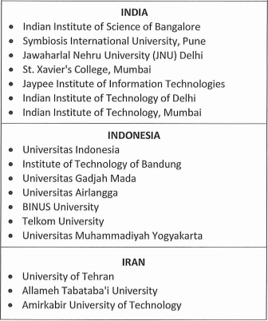
A4U Erasmus+ Call
Call for Applications 2017 Erasmus KA107
Scholarships for incoming mobility from associated countries
A4U Institutions:
Universidad Autónoma de Barcelona
Universidad Autónoma de Madrid
Universidad Carlos III de Madrid
Universidad Pompeu Fabra
Open for applications!
Notes:
There are 77 universities in Spain, 50 of which are public
The A-4U represents 4 of the more outstanding public universities.
Each member is a young and dynamic institution that has made great contributions to the Spanish university system.
Each member has been recognised by the Spanish Ministry of Education as a Campus of International Excellence, in recognition of research and teaching excellence and a strong international projection.
All four universities provide a full range of university studies and research interests, from the Humanities through to Social Sciences, Technology and Experimental Sciences.
In this sense, the A-4U has common characteristics that facilitate their joint projects and activities.

Slide 14
Who can apply for a scholarship?
A4U Erasmus+ Call
PhD Students and Staff from Higher Education Institutions
of the partner countries:
Currently opened call:
PhD
Academic Staff
(Teaching 8 hours/per week -Excluding conferences-)
To be published:
Undergraduate Students
Master Students
Notes:
There are 77 universities in Spain, 50 of which are public
The A-4U represents 4 of the more outstanding public universities.
Each member is a young and dynamic institution that has made great contributions to the Spanish university system.
Each member has been recognised by the Spanish Ministry of Education as a Campus of International Excellence, in recognition of research and teaching excellence and a strong international projection.
All four universities provide a full range of university studies and research interests, from the Humanities through to Social Sciences, Technology and Experimental Sciences.
In this sense, the A-4U has common characteristics that facilitate their joint projects and activities.

Slide 15
A4U International Call
International Mobilities under Erasmus+ (2017-2019) for Iran
COUNTRY |  |  | MOBILITIES |  |  |  |  |  |  |  | TOTAL
 |  |  | Bachelor |  | Master |  | PhD |  | Faculty
IRAN | IN |  | - |  | - |  | 3 |  | 4 |  | 7 | 14
 | OUT |  | - |  | - |  | 3 |  | 4 |  | 7
In this edition, no mobility grants for Bachellor and Master students…
Notes:
Just over 2 years ago, at the beginning of 2008, 4 universities (2 from Barcelona and 2 from Madrid), namely, the Universitat Autònoma de Barcelona, the Universidad Autónoma de Madrid, the Carlos III University of Madrid and the Pompeu Fabra university, all of them based on a strong connection between academic research and quality teaching, all of them among the very best centres of higher education in Spain and in the European Union for their teaching quality, the excellence of their research and their capacity for innovation, decided to formalise their collaboration. And so the Alliance of these 4 universities, the A4U, was created. It is an innovative structure both in Spain and in Europe.

Slide 16
A4U Erasmus+ Call
Scholarhips for students/staff from associates countries to A4U:
Monthly Allowance for PhD students and Staff:
PhD Students: 800€/month
Academic Staff: 120€/day
Travel costs:
820€
(Fixed by the Erasmus+ programme for the specific country)
No tuition fees
*Beneficiaries should have an adequate insurance!
Notes:
We are national leaders in quality of teaching and research
We are the four Main Spanish actors in Europe and account for 20% of the total Spanish Universities participation in European Union programmes
Each university has been officially recognised as a Campus of International Excellence by the Spanish Ministry of Education.
All four universities house Research Parks and have generated a considerable number of spin-off companies in Spain.
We are officially supported by the Spanish government through agreements with the Spanish Institute for Foreign Trade (ICEX) and Spanish National Research Council (CSIC)
United by many years of good relationships, mutual collaboration, and shared commitment to high-quality scientific research and teaching excellence.

Slide 17
Requirements to be elegible…
PhD applicants must:
Be enrolled in one of the partner universities
Be nominated for mobility by one of the partner universities
Submit Mobility Agreement Proposal
Academic Staff must:
Have a contractual relationship at the time of application/mobility
Submit a Mobility Agreement Proposal for teaching staff accepted by the sending & hosting institution
All mobility activities are conditional upon the signature of an INTERINSTITUTIONAL AGREEMENT between host and home universities before the start of the mobilities, according the Erasmus+ programme rules.
Notes:
Our joint project, OPERA (Office for the Promotion of European Research Activities) , is an initiative aimed at:
Supporting the A-4U to achieve better and more competitive research at European and international level.
Identifying new policies and funding opportunities of interest to the A-4U.
Participating in and influencing R&D&I European policy decision-making.
Providing personalized assistance in Europe to A-4U researchers.

Slide 18
Required documents
Level | Documents
Faculty/ Staff | Application Form (online) Abridged CV Mobility Agreement for teaching/training
PhD | Application Form (online) CV Learning Agreement Recommendation Letter
Notes:
Our joint project, OPERA (Office for the Promotion of European Research Activities) , is an initiative aimed at:
Supporting the A-4U to achieve better and more competitive research at European and international level.
Identifying new policies and funding opportunities of interest to the A-4U.
Participating in and influencing R&D&I European policy decision-making.
Providing personalized assistance in Europe to A-4U researchers.

Slide 19
Selection criteria
Evaluation criteria for PhD students:
Quality of the research proposal
Academic qualifications and research experience
Matching with research areas at host university
Evaluation criteria for Teaching Staff:
Quality of the proposal
Relevance and expected impact for the host and home universities
CV including teaching experience, research and pubblications
Notes:
The A-4U has been very active in promotional activities in many parts of the world, as this slide shows. In addition to our current visit, we are also involved in activities in Chile and will soon be collaborating with universities in Brazil and Russia.

Slide 20
Requirements to be elegible…
Mobilities must be completed between…
2nd semester of 2017-2018 academic year
1st semester of 2018-2019 academic year
Always before 31 July 2019!!
Notes:
Our joint project, OPERA (Office for the Promotion of European Research Activities) , is an initiative aimed at:
Supporting the A-4U to achieve better and more competitive research at European and international level.
Identifying new policies and funding opportunities of interest to the A-4U.
Participating in and influencing R&D&I European policy decision-making.
Providing personalized assistance in Europe to A-4U researchers.

Slide 21
How to apply?
Online Application
http://alliance4universities.eu/en/mobility-scholarships/
Notes:
The A-4U has been very active in promotional activities in many parts of the world, as this slide shows. In addition to our current visit, we are also involved in activities in Chile and will soon be collaborating with universities in Brazil and Russia.

Slide 22
Deadline for applications:
Contact: coordinacion@a-4u.eu
PhD/ Staff | 2nd February 2018
Notes:
The A-4U has been very active in promotional activities in many parts of the world, as this slide shows. In addition to our current visit, we are also involved in activities in Chile and will soon be collaborating with universities in Brazil and Russia.

Slide 23
Thank you for your attention!
Notes:
Namaste [namasté].
Ladies and gentlemen, distinguished guests, fellow rectors,
As President of the Alliance, it is a great pleasure for me to be here and to present our partnership to you.

